Slide 1

Data Science Project
Group 10 (Mark, Muaz, Osama, Rami, & Ziad)
Delivering an Actionable Insight

Slide 2


Project analysis slide 2
Project Framework
6. AUDITING
MARK
1. GUIDELINES
MUAZ
Project Framework & Responsibility
5. REPORT
RAMY & MUAZ
2. KMEANS
ZIAD
4. VISUALIZATIONS
MUAZ & OSAMA
3. APRIORI
ZIAD

Slide 3
Project analysis slide 3
Project Majors
What will the Project do?
What are the Inputs?
What are the Outputs?
The program will take a dataset path and use it to apply certain formulas and build insightful charts for deeper understanding of the data.
Splitting the customers into groups (clusters).
Generating association rules used to help for predictive analysis.
Dataset path is where the master data is located.
Number of clusters will be used for the K-means, ranged between 2 ≤ 𝑥 ≤ 4
Number of minimum support and minimum confidence will be used for the Apriori algorithm, ranged between 0.001 ≤ 𝑥 ≤ 1
Visualization charts to describe the problems insightfully, through presenting the clustered customers based on the user input
Association rules based on the user inputs of minimum support and minimum confidence by using the Apriori algorithm.

Slide 4
Project analysis slide 4
Project Charter
Proper Forecasting
* Cashflow Management.
* Proper Customer Services.
Dataset
Requirements
Project Objectives
Patterns of Consumption
* Enhancing the Shelfing and offers positioning.
Imaginary Stakeholders
Potentiality per Category
* Effective Customized Marketing Plan.

Slide 5






Project analysis slide 2
Project Phases
6. ACT
1. ASK
Project Phases
5. SHARE
2. PREPARE
4. ANALYZE
3. PROCESS

Slide 6
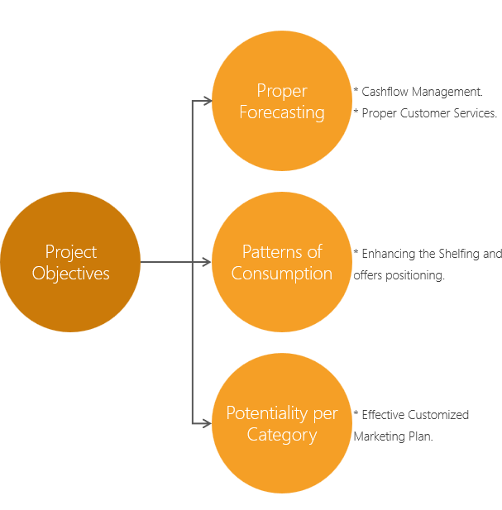
Project analysis slide 10
Ask
In this phase, we defined the problem to be solved and we made sure that we have fully understood stakeholder’s expectations.
In our case are the data generators or imaginary stakeholders.
Through a brainstorming process, we tried to define some problems to look at the current state (received from the dataset) and identify how it's different from the ideal state that we want to drive the business to.

Slide 7
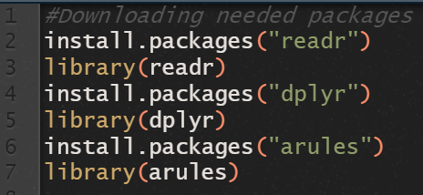

Project analysis slide 10
PREPARE
.
We also prepared our tools in R
Readr: To read the CSV file
Dplyr: To select and group data
Arules: Used for the Apriori algorithm
Features as sort & filter
Importing the dataset to R
Preparing data for the Apriori algorithm

Slide 8




Project analysis slide 10
PROCESS
We removed column rnd since it was meaningless.
After getting the unique item list and their count. We’ve found two duplicates “cream cheese” and “roll products”.
They were caused by a mistake from the data entry process.
According to the “get occurrence” method I used; it doesn’t remove the ending space in the words between commas but do remove extra spaces if it was the last item since there are no commas beyond.
There were 24 “cream cheese” at the end of the item list which resulted to no extra space, while there were 366 “cream cheese” in between the comas which resulted to an extra space at the end.
Same goes to “roll products”.
So, we removed the row with the extra space of the item list and edited the row with no extra space with the total item count.

Slide 9
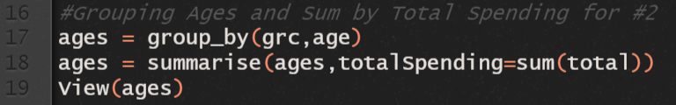
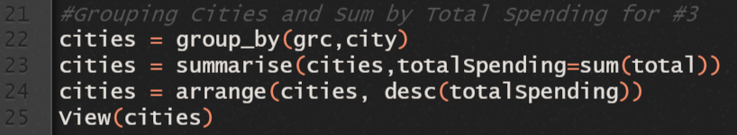
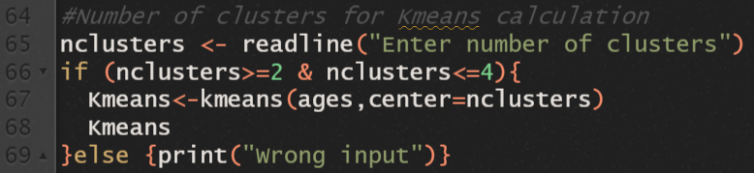
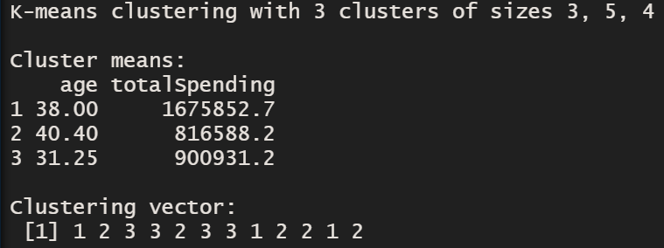
Project analysis slide 10
ANALYZE 1
We created a new table with all ages and their total spending.
We created a new table with all cities and their total spending by descending order.
We calculated the number of clusters using the R built in function. We also made data validation for the user input
Assuming that the number of clusters we have are 3… The cluster points are {(38.00, 1675852.7), (40.40, 816588.2), (31.25, 900931.2)}
And the clustering vector is
{1, 2, 3, 3, 2, 3, 3, 1, 2, 2, 1, 2}
Based on the age group
{22, 23, 25, 29, 30, 35, 36, 39, 50, 55, 60}

Slide 10
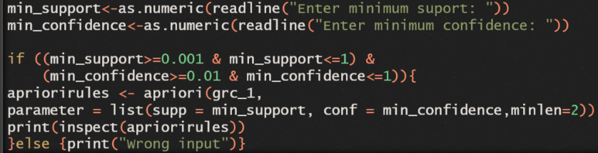
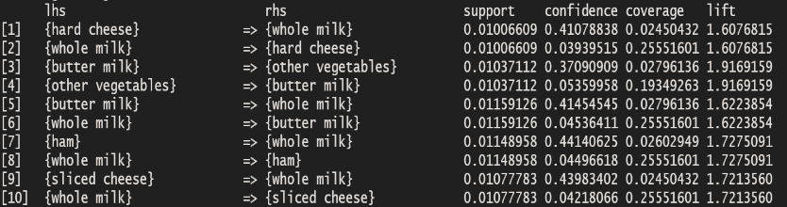
Project analysis slide 10
ANALYZE 2
Ages | 22 | 23 | 25 | 29 | 30 | 35 | 36 | 37 | 39 | 50 | 55
Clusters | 1 | 2 | 3 | 3 | 2 | 3 | 3 | 1 | 2 | 2 | 1
We made association rules between items based on the user minimum support and minimum confidence with data validation as well.
Assuming that the minimum support is 0.01 and minimum confidence is 0.01… that is a sample of the first 10 association rules from the Apriori algorithm.

Slide 11
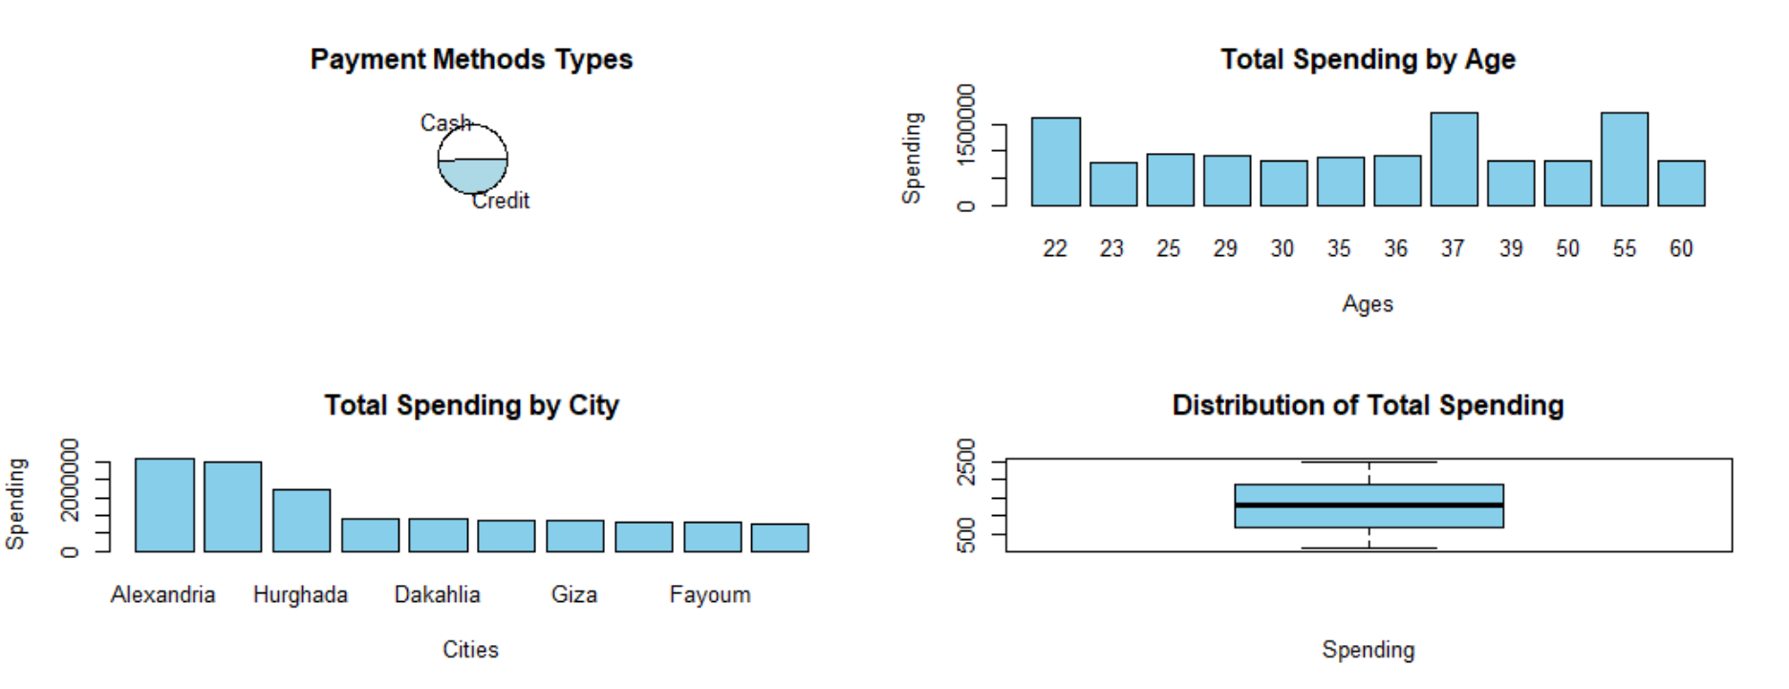
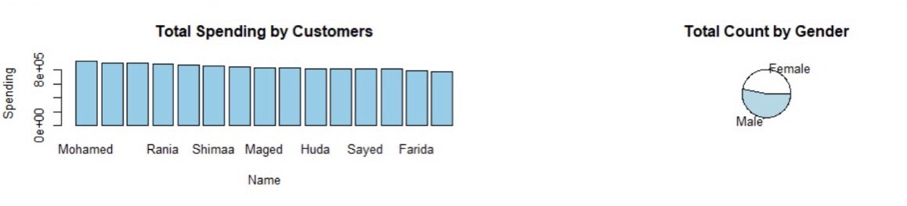
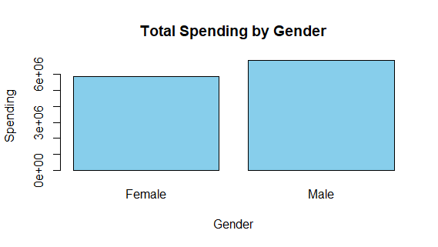
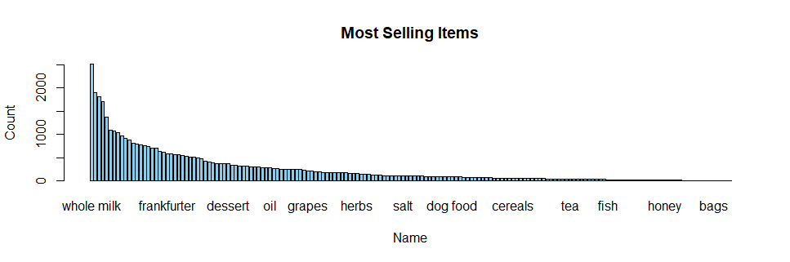
Project analysis slide 10
SHARE
Cash spending are slightly more than Credit spending.
Ages 22, 37, and 55 are the most spending.
Alexandria, Cairo, and Hurghada are the most spending cities.
Minimum of total spending is 100.
Maximum of total spending is 2500.
Median of total spending is approximately 1250.
The most 3 spending customers are “Mohamed”, “Magdy”, and “Walaa”.
Male’s count is slightly more than Female’s.
Male’s total spending is more than Female’s.
We sorted out all items from “Z” to “A” as per repeated transactions (count).
The most 3 selling items are “whole milk”, “other vegetables”, and “rolls/buns”.
The least 3 selling items are “baby food”, “sound storage medium”, and “preservation products”.

Slide 12
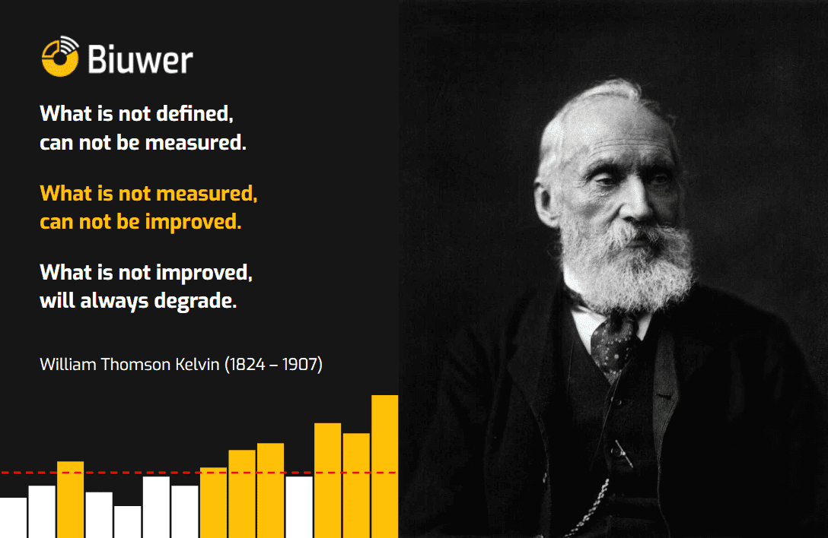
Project analysis slide 10
ACT
This is the exciting moment when the grocery’s stakeholders took all the necessary insights our team have provided and puts them to work in order to solve the original business problem. We should be in on-going contact with the stakeholders and the updated dataset which will be received to monitor the impact of recommended actions and taking all necessary corrective actions -if needed-.

Slide 13
Thank You
Group 10

